Slide 1
Workshop 9
Microservices with Spring Boot & Eureka Naming Server

Slide 2
What is Eureka Naming Server?
Naming Server: The naming server is a computer application that implements a network service for responding to queries against a directory service.
Eureka naming server is a REST-based server that is used in the AWS Cloud services for load balancing and failover of middle-tier services.
Microservices can discover each other with the help of the naming server using service name, it is not necessary to knowing each other’s actual IP address.

Slide 3
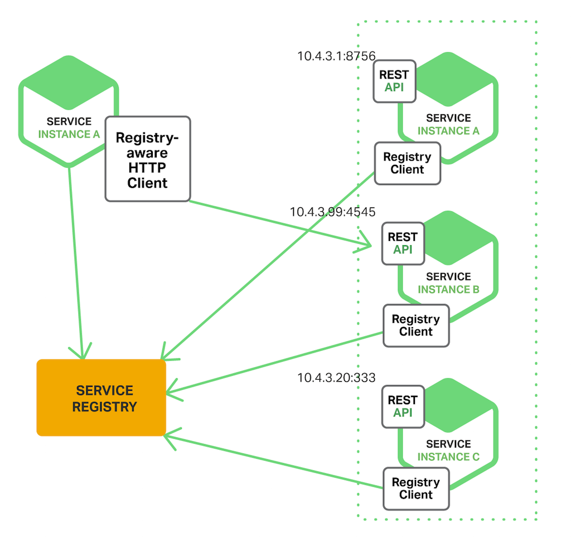
What is Eureka Naming Server?

Slide 4
Hello & World Microservice
HelloService
(hello-service)
Client
HelloWorld
Application
WorldService
(world-service)
NamingServer

Slide 5
Tasks
1. Create and Configure NamingServer
2. Create and Configure Hello Service
3. Create and Configure World Service
4. Create Hello World Application using Hello and World Service

Slide 6
Tasks
1. Create and Configure NamingServer
2. Create and Configure Hello Service
3. Create and Configure World Service
4. Create Hello World Application using Hello and World Service

Slide 7
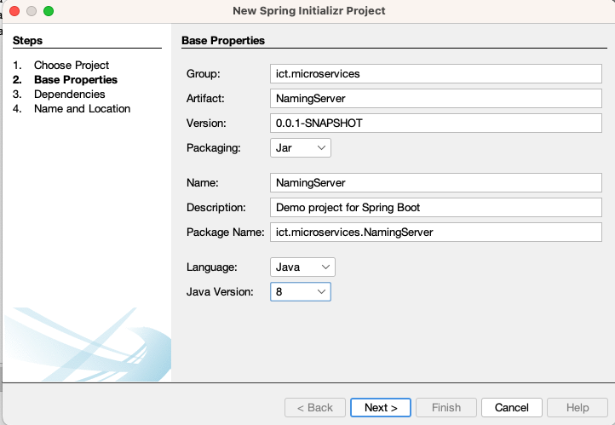
Create Project for Naming Server
Create a Spring Initialzr Project
17

Slide 8
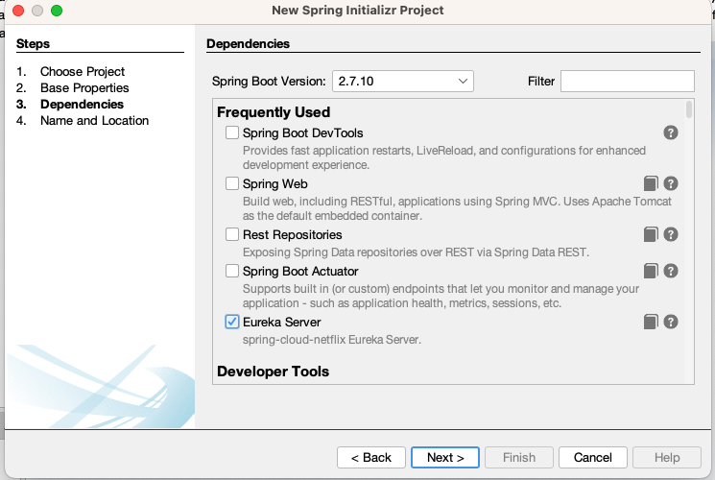
Create Project for Naming Server
Spring Boot Version: 3.2.4 & Add Eureka Server as Dependencies
3.2.4

Slide 9
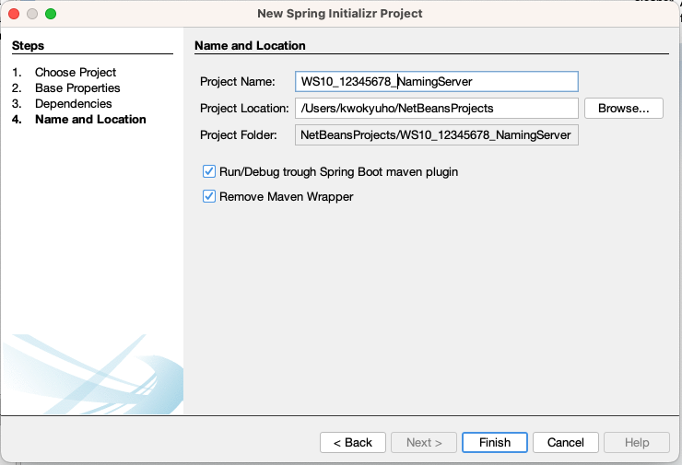
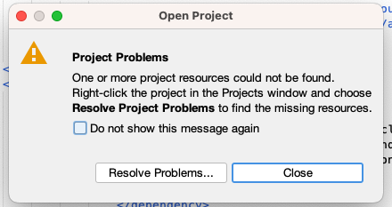
Create Project for Naming Server
Create a Spring Initialzr Project
Click Resolve Problem…
In case the IDE prompt this
message

Slide 10
Create Project for Naming Server
Setup application.properties
# Set the port where Eureka Server will run
server.port=8761
# This app is a Eureka Server, not a client
# So it should not register itself or fetch the registry
eureka.client.register-with-eureka=false
eureka.client.fetch-registry=false
# Optional (but useful)
spring.application.name=eureka-server

Slide 11
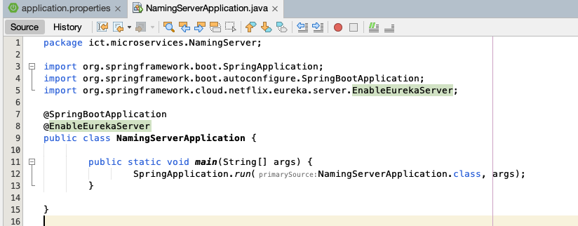
Create Project for Naming Server
Update NamingServerApplication.java
@EnableEurekaServer

Slide 12
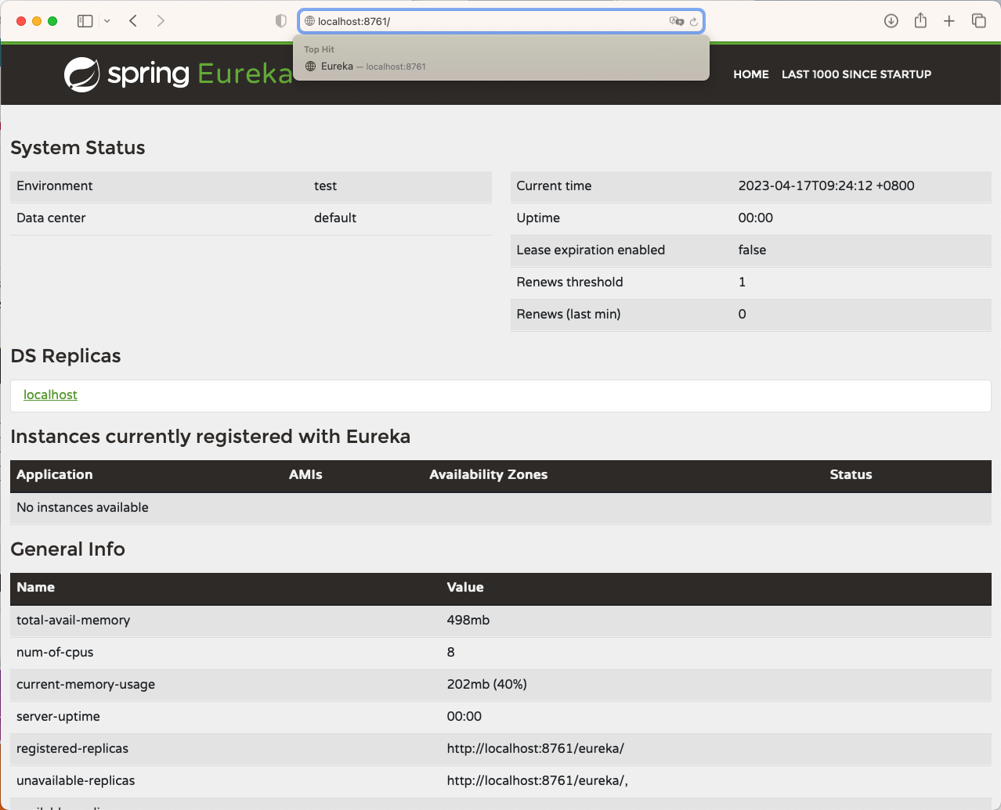
Create Project for Naming Server
http://localhost:8761/
Start the service and check http://localhost:8761

Slide 13
Tasks
1. Create and Configure NamingServer
2. Create and Configure Hello Service
3. Create and Configure World Service
4. Create Hello World Application using Hello and World Service

Slide 14
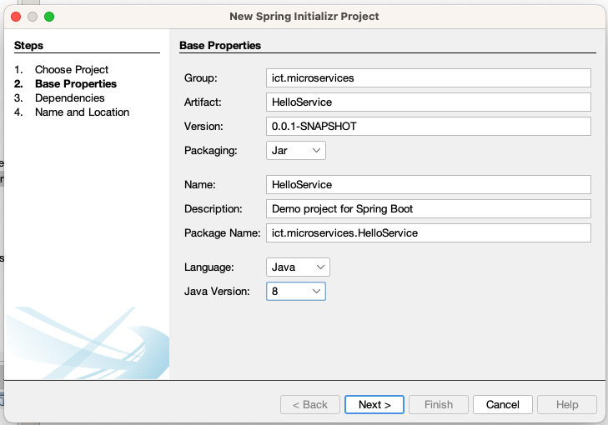
Create Project for Hello Service
Create Project
17

Slide 15
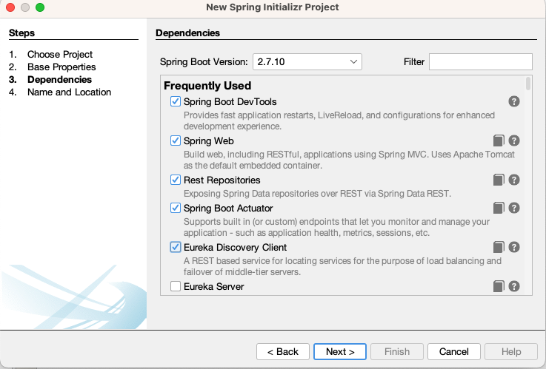
Create Project for Hello Service
Spring Boot Version 3.2.4, Must Add Eureka Discovery Client!!!
3.2.4

Slide 16
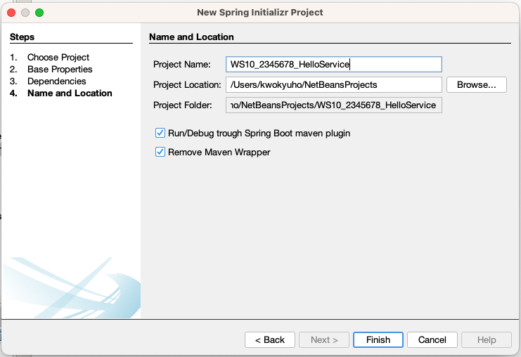
Create Project for Hello Service
Create Project

Slide 17
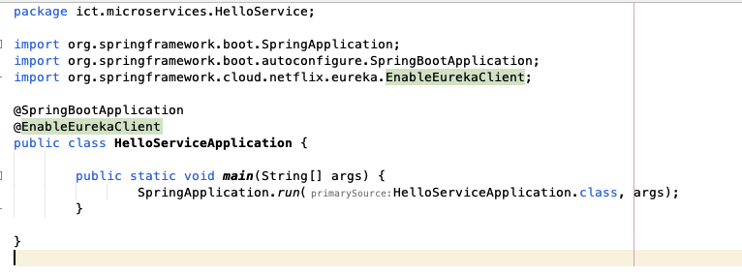
Create Project for Hello Service
Update HelloServiceApplication.java
org.springframework.cloud.client.discovery.EnableDiscoveryClient;
@EnableDiscoveryClient

Slide 18
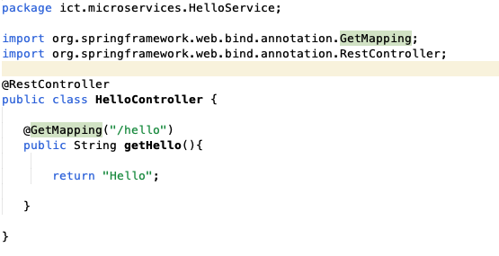
Create Project for Hello Service
Create a Class HelloController

Slide 19

Create Project for Hello Service
Setup application.properties
# Name of the service as it will appear in Eureka
spring.application.name=hello-service
# Port to run this microservice on
server.port=8083
# Eureka server URL for registration and discovery
eureka.client.service-url.defaultZone=http://localhost:8761/eureka

Slide 20
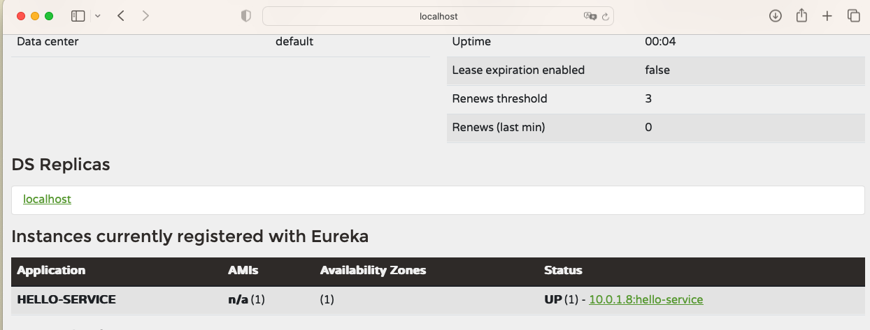
Create Project for Hello Service
Run the server and check Eureka Server (http://localhost:8761)

Slide 21
Tasks
1. Create and Configure NamingServer
2. Create and Configure Hello Service
3. Create and Configure World Service
4. Create Hello World Application using Hello and World Service

Slide 22

Create Project for World Service
Try to repeat the Step to create another project named WorldService
Make the Spring Boot Application a Eureka Client (DiscoveryClient)
Create a RestController (WorldController), and define a GetMapping to /world, which will return the String “World”
Setting the server’s application.properties file with configuration shown below.

Slide 23
Tasks
1. Create and Configure NamingServer
2. Create and Configure Hello Service
3. Create and Configure World Service
4. Create Hello World Application using Hello and World Service

Slide 24
Hello World Application
With the help of the Eureka Naming Server, we can make an application reference to the service name url without communicating with the microservices using IP address

Slide 25
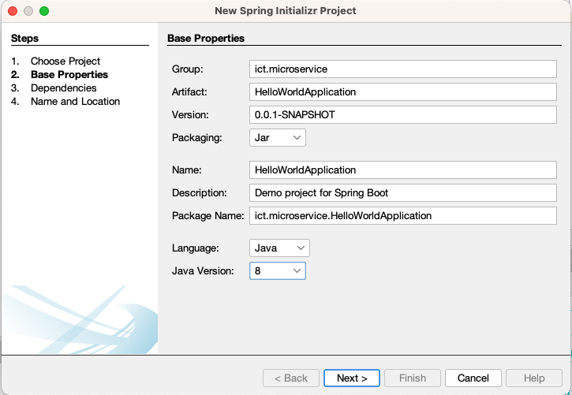
Create Project for Hello Service
Create a HelloWorldApplication
17

Slide 26
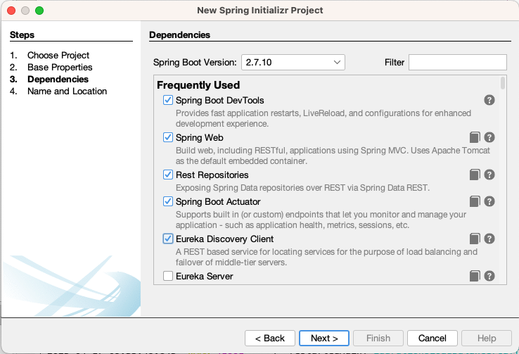
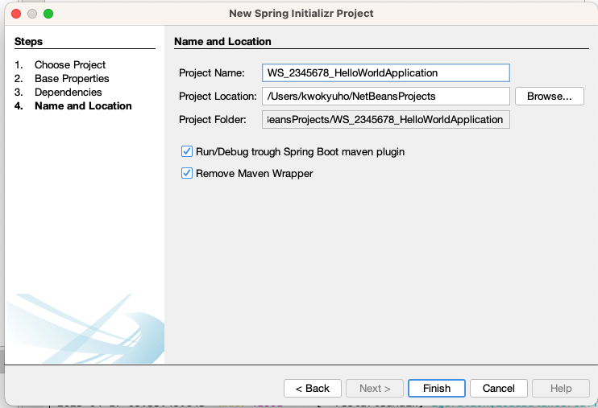
Create Project for Hello Service
Create a HelloWorldApplication
3.2.4

Slide 27
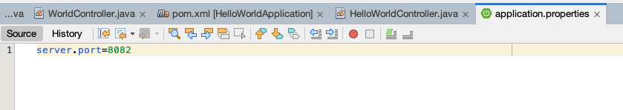
Create Project for Hello Service
Setup the application.properties file

Slide 28
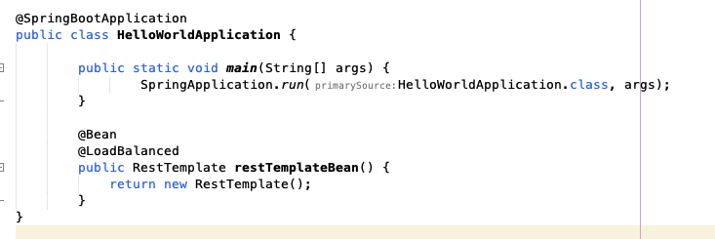
Create Project for Hello Service
At HelloWorldApplication .java setup a RestTemplate for retrieving return from other microservices (Will talk about it later)
RestTemplate is a Spring tool used to make HTTP requests to other microservices.
@Bean makes this object available for the whole application
@LoadBalanced
allowing you to call services by name

Slide 29
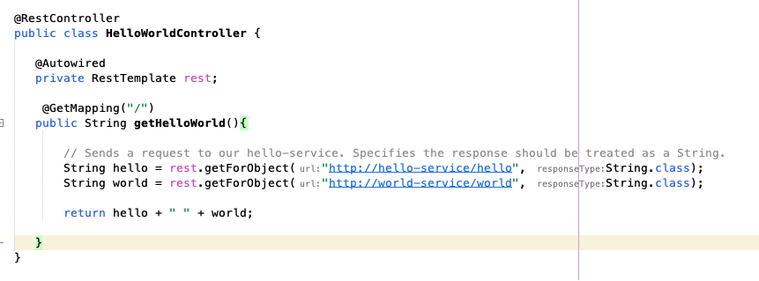
Create Project for Hello Service
Create HelloWorldController class, make use of the registered microservices using RestTemplate

Slide 30
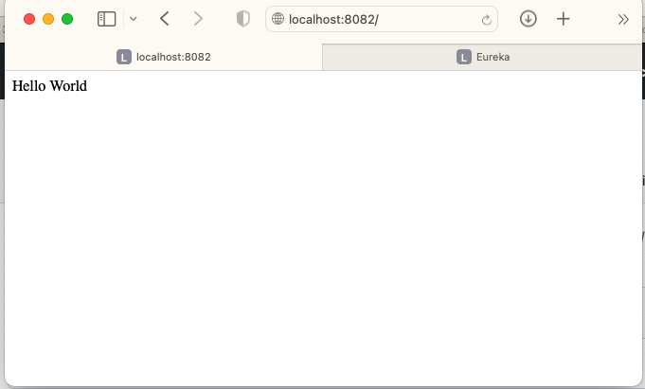
Create Project for Hello Service
Build and run the application (http://localhost:8082)

Slide 31
Tasks
1. Create and Configure NamingServer
2. Create and Configure Hello Service
3. Create and Configure World Service
4. Create Hello World Application using Hello and World Service
5. Extra Task (optional): Try to integrate the Customer Service in WS9, using the HelloWorldApplication to draw any one (fixed id value is ok) customer JSON and show it after ”Hello World”.

